Slide 1
Deep Learning Final Project
Genre Recognition
Lior Breitman 212733257
Talia Seada 211551601
Netanel Levine 312512619

Slide 2



The problem
Given a song we would like to know its genre.
Music genre classification is a challenging task due to the complex and subjective nature of music.
It is an important problem with many practical applications, such as music recommendation systems and playlist generation.

Slide 3
Workflow
Feature extraction from multiple WAV files to a single CSV file
Preprocessing the data: normalizing, cross correlation and balancing
Creating the CNN
Training the model
Evaluating

Slide 4
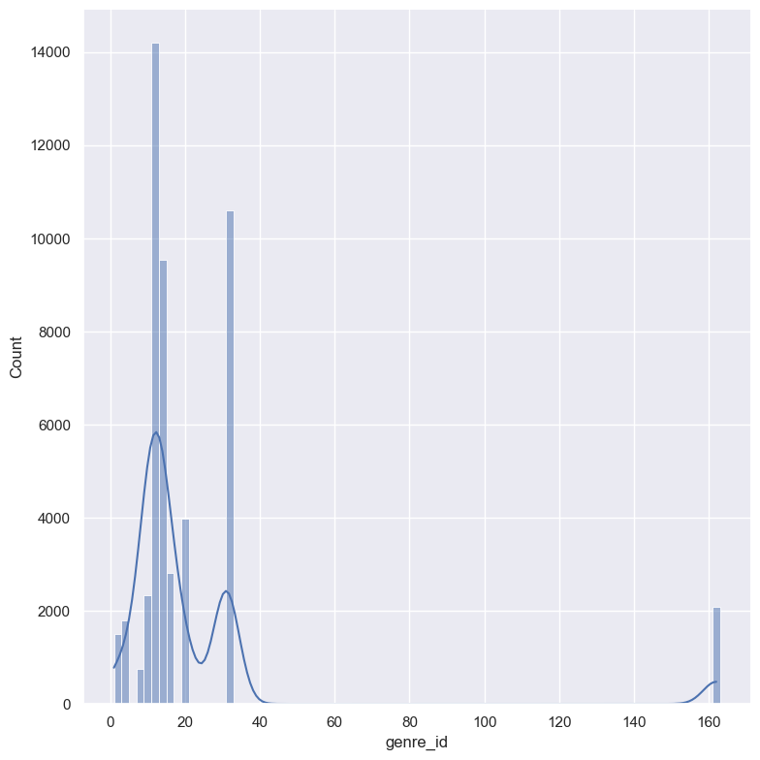
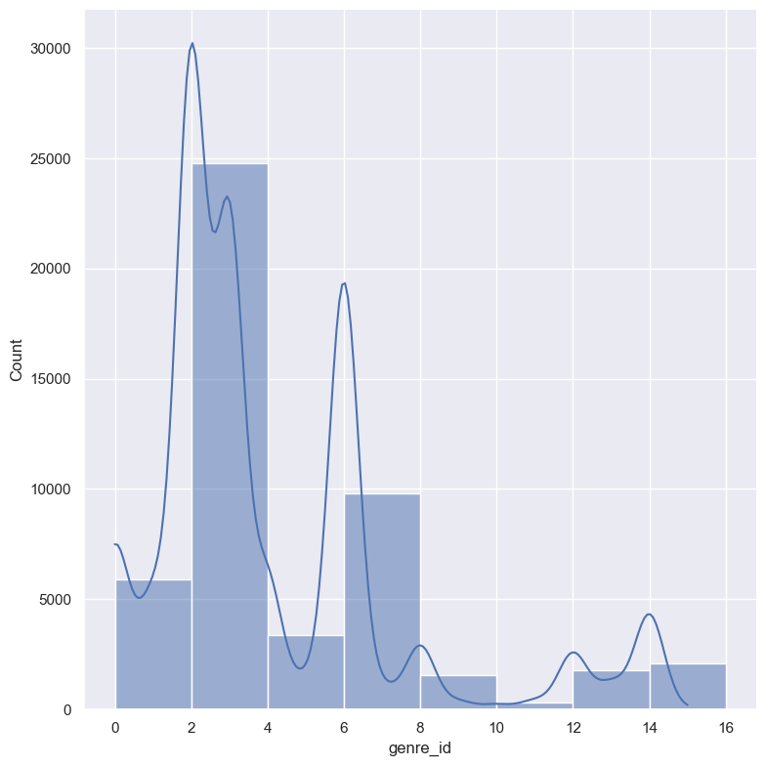
PREPROCESSING THE DATA
Our dataset contains almost 40k samples (30 sec each) of songs distributing among 161 genres.
As part of our preprocessing, we decided to reduce the number of classes by removing the classes that no song is belong to them.
Before
After

Slide 5
Normalizing – normalize the data using the mean and the std of our data and the following formula: (data – mean) / std
Cross correlation -
Balancing -

Slide 6
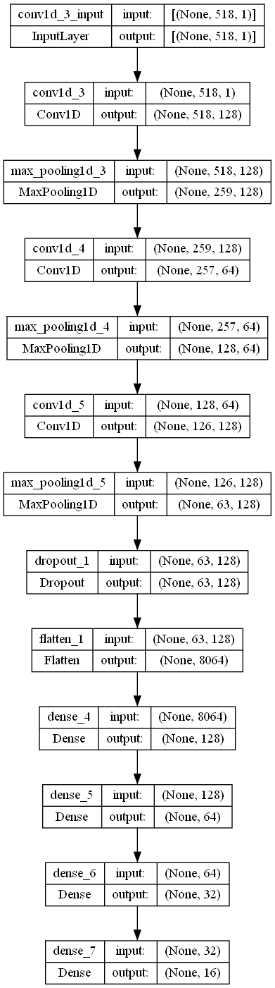
Creating the CNN
Our model contains eleven different layers. We have:
Three 1D Convolution layers
Three 1D MaxPooling layers
One Dropout layer
One Flatten layer
Four Dense layers

Slide 7
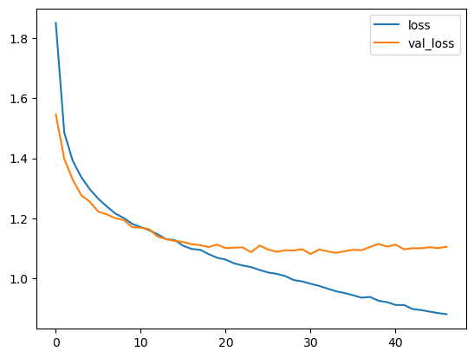
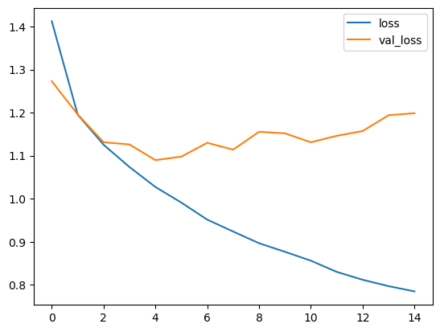
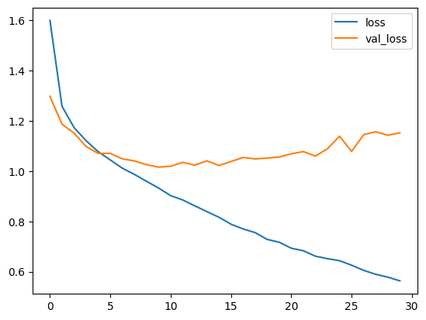
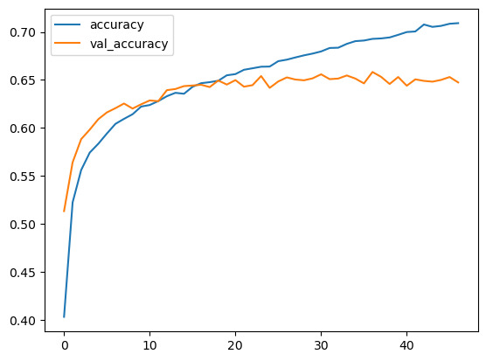
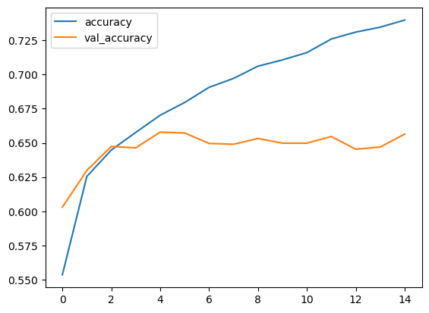
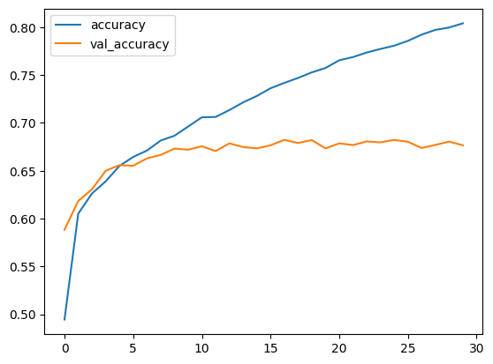
TRAINING THE MODEL BEFORE
63.1%
65.2%
67.8%

Slide 8
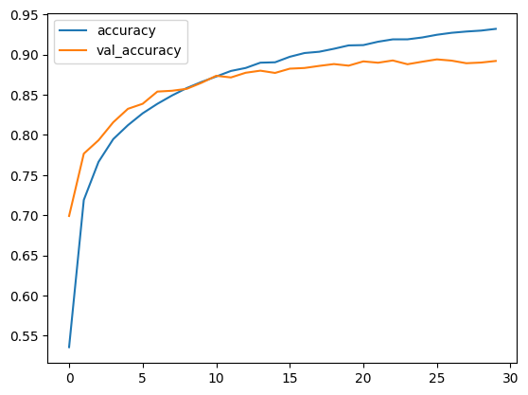
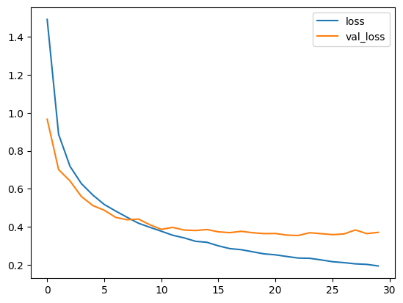
TRAINING THE MODEL AFTER
89.0%

